Slide 1
App Container
Software Industry
Main Nav Container
Computer Science
Snow Sports

Slide 2
Tab Nav Container
Software Industry
Computer Science
Snow Sports
Content Container

Slide 3
Software Industry
Software Industry
Computer Science
Snow Sports
Software Industry
Computer Science
Snow Sports

Slide 4
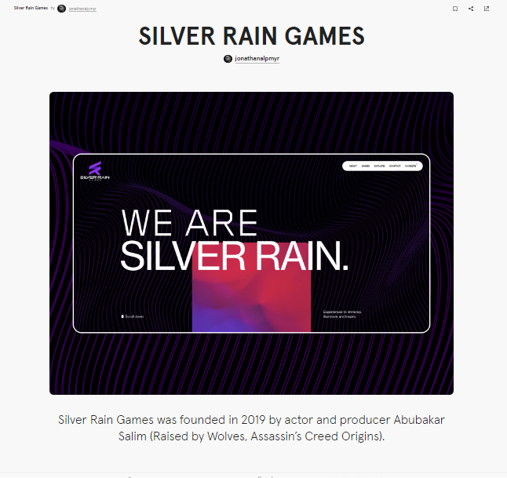
https://blog.hubspot.com/website/react-websites-examples
https://blog.hubspot.com/website/react-websites-examples

